Slide 1
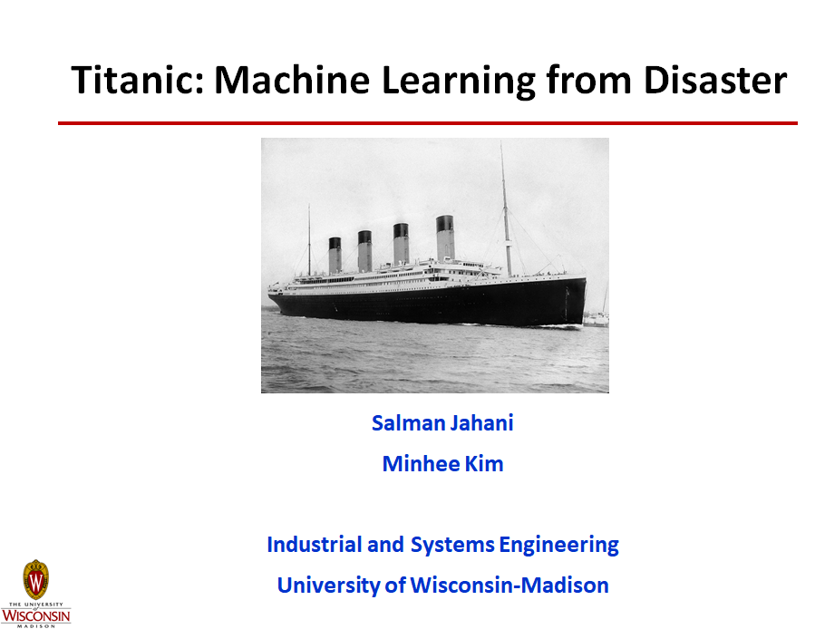

Slide 2
Outline
Data set Description
Correlation Matrix
Missing Variables
Feature Engineering
Feature Scaling
Model Training and Evaluation

Slide 3
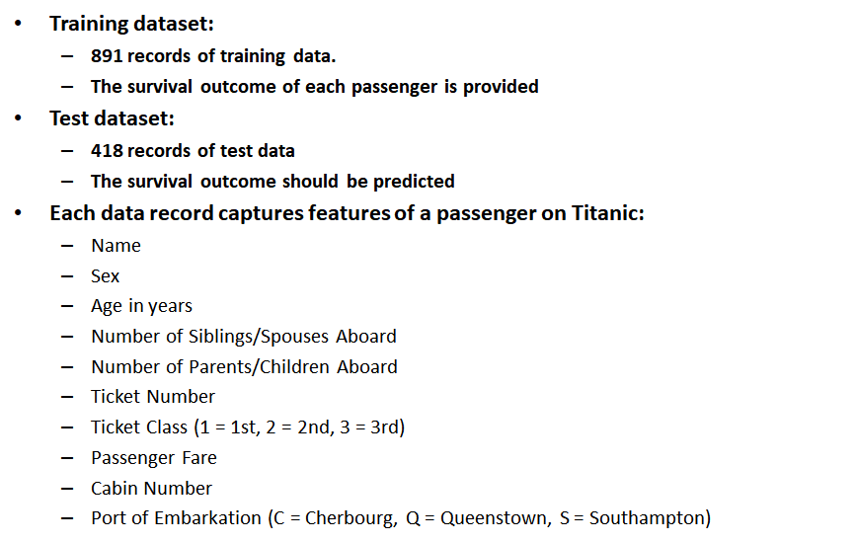
Data set

Slide 4
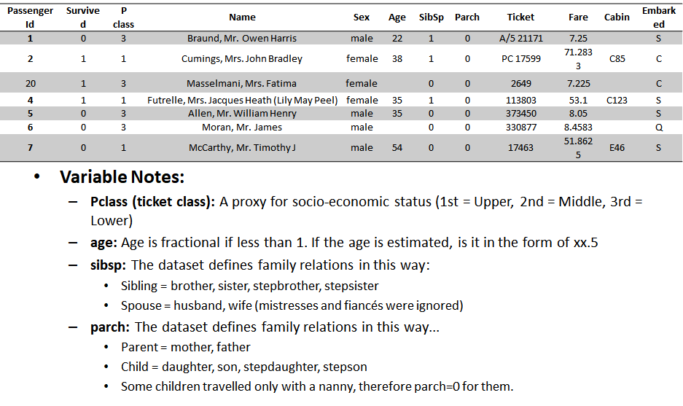
Data set (cont’d)

Slide 5
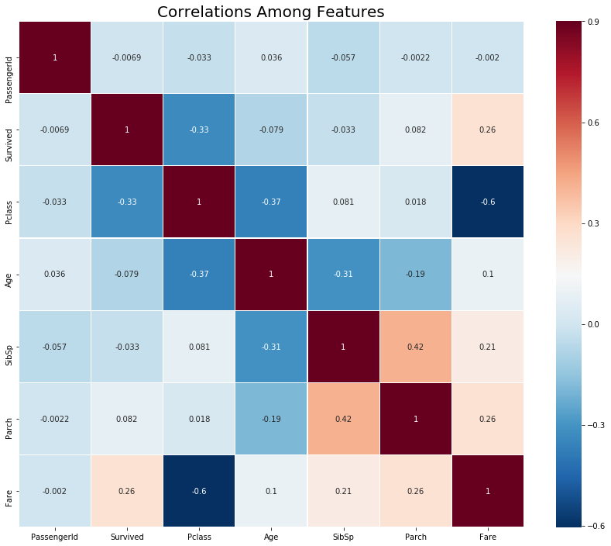
Correlation Matrix/Heat map

Slide 6
Correlation Matrix/Heat map (Cont’d)
Positive Correlation Features:
Fare and Survived: 0.26
Parch and Sigsp: 0.42
Negative Correlation Features:
Fare and Pclass: -0.6
Sex and Survived: -0.55
Pclass and Survived: -0.33
The passenger who paid more money for their ticket were more likely to survive.
The most significant correlation with our dependent variable is the Sex variable.

Slide 7
Missing Variables (Embarked Feature)
 | Total | Percent
S | 644 | 72.28
C | 168 | 18.86
Q | 77 | 8.64
NaN | 2 | 0.22
We may be able to solve these two missing values by looking at other independent variables of the two rows
Only two values are missing in the Embarked feature
PassengerId | Survived | Pclass | Name | Sex | Age | SibSp | Parch | Ticket | Fare | Cabin | Embarked
62 | 1 | 1 | Icard, Miss. Amelie | female | 38 | 0 | 0 | 113572 | 80 | B28 | NaN
830 | 1 | 1 | Stone, Mrs. George Nelson (Martha Evelyn) | female | 62 | 0 | 0 | 113572 | 80 | B28 | Nan

Slide 8
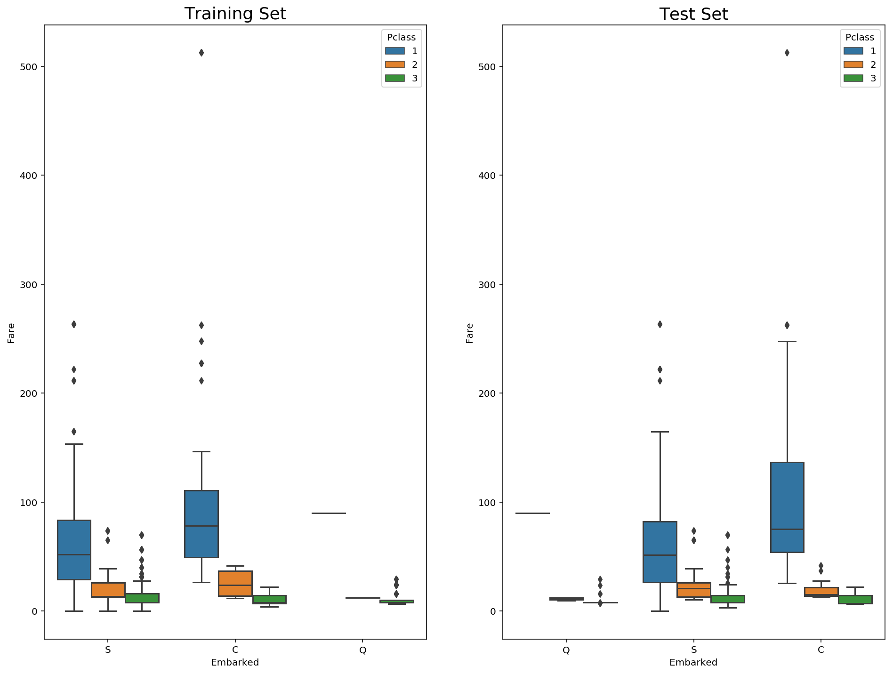
Missing Variables (Embarked Feature)
Both passengers paid a fare of $80, are of Pclass 1 and female
The average fare closest to $80 are in the C Embarked values.

Slide 9
Missing Variables (Cabin Feature)
77% of Cabin feature in train data and 78% of Cabin feature in test data is missing.
Inappropriate way of replacing missing variables can cause significant errors.
Drop Cabin Feature
PassengerId | Survived | Pclass | Name | Sex | Age | SibSp | Parch | Ticket | Fare | Cabin | Embarked
28 | 0 | 1 | Fortune, Mr. Charles Alexander | male | 19 | 3 | 2 | 19950 | 263 | NaN | S
… | …
89 | 1 | 1 | Fortune, Miss. Mabel Helen | female | 23 | 3 | 2 | 19950 | 263 | NaN | S

Slide 10
Missing Variables (Fare Feature)
Only one record is missing:
We can impute the missing values by the average of fare column
The average of fare where Pclass is 3, Sex is male and embarked is S is 12.71.
PassengerId | Pclass | Name | Sex | Age | SibSp | Parch | Ticket | Fare | Cabin | Embarked
1044 | 3 | Storey, Mr. Thomas | male | 60.5 | 0 | 0 | 3701 | NaN | B | S

Slide 11
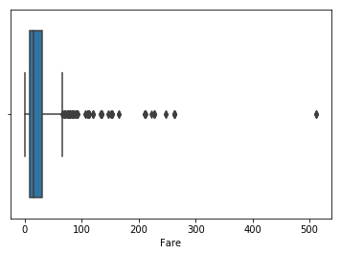
Outliers (Fare Feature)
Remove the three outliers whose fare is over $500

Slide 12
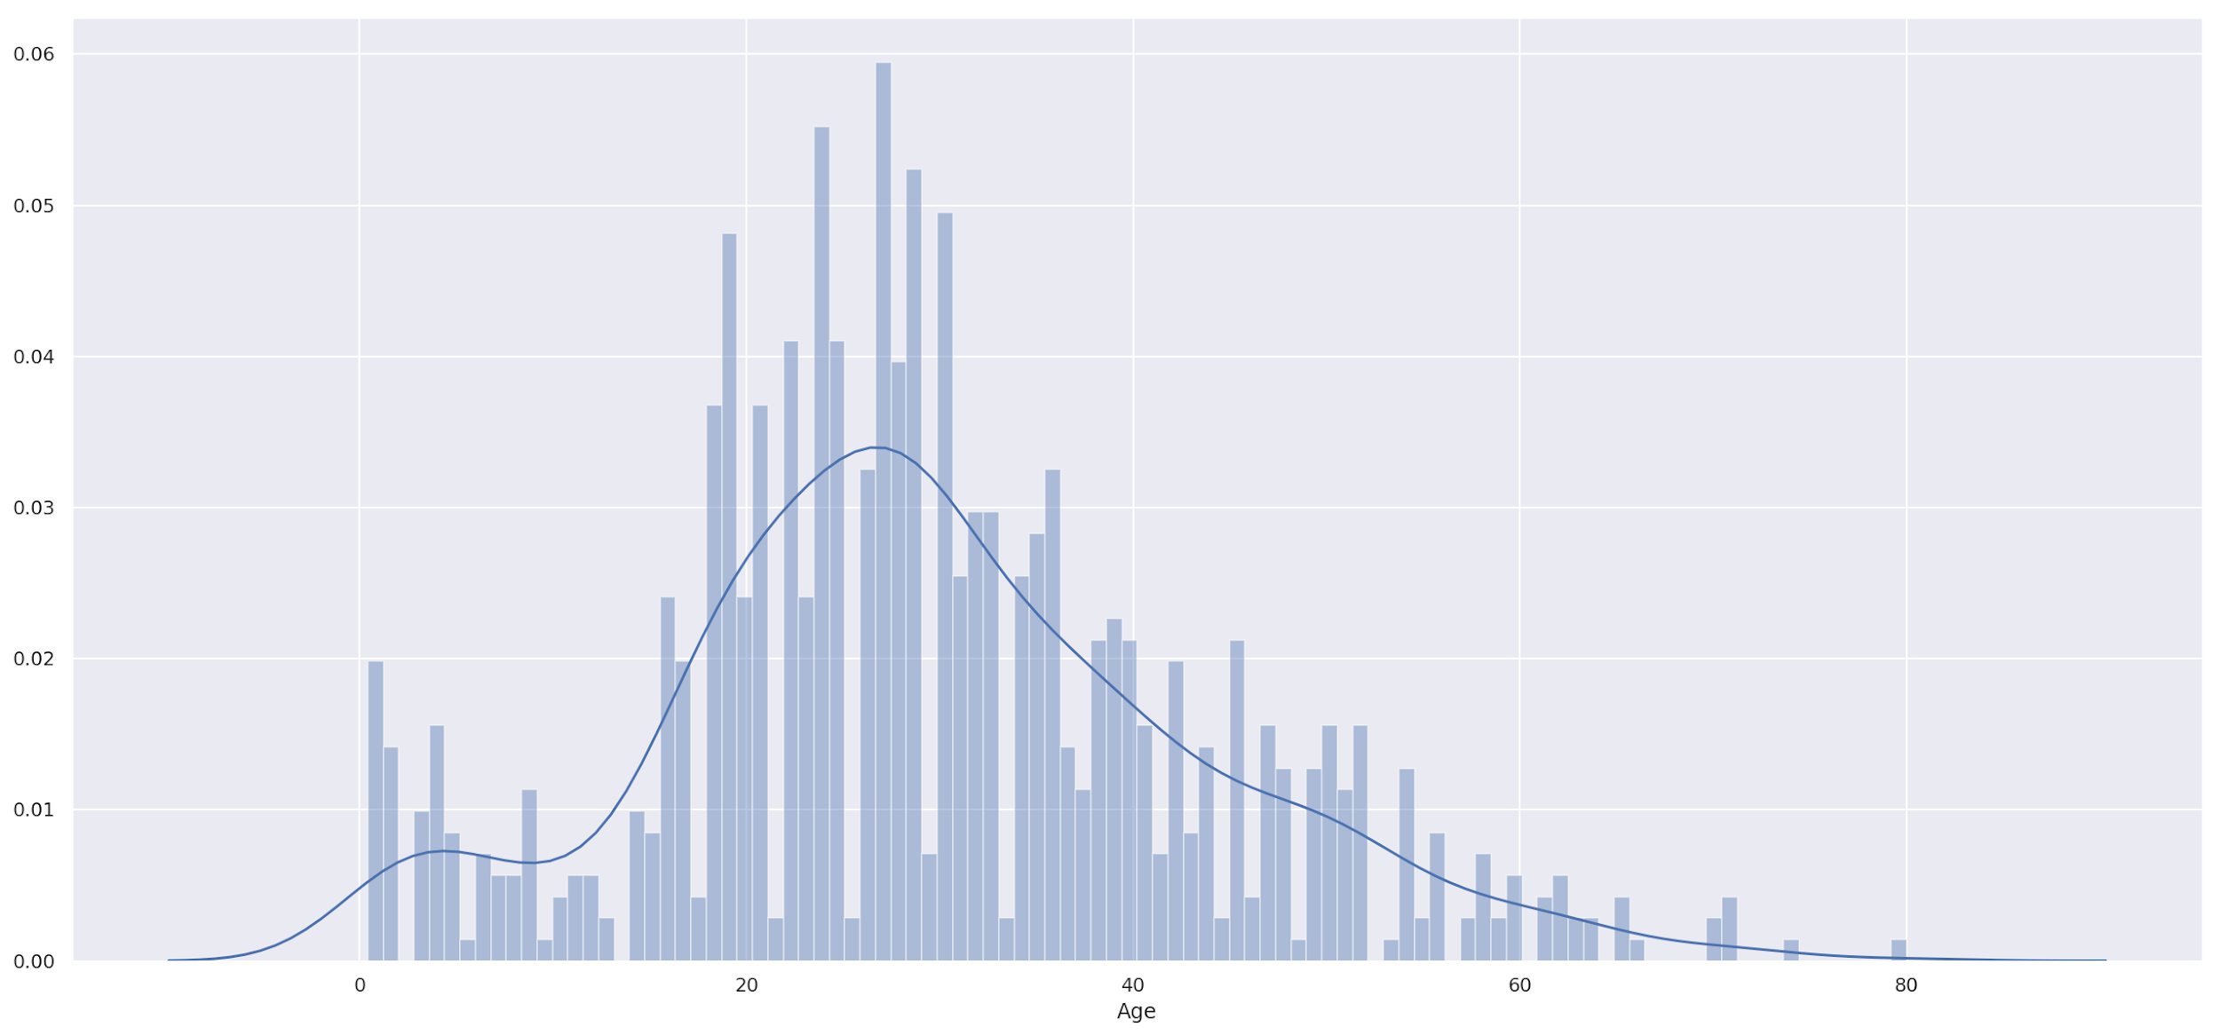
Missing Variables (Age Feature)
The simpliest way to impute missing values of a variable is to use mean, median or mode.
However 20% data in the Age column is missing.
We use Random Forest Regressor to predict the missing age values

Slide 13
Feature Engineering
Modify or create new features from the existing features which are otherwise hard to analyse in their raw forms.
New features can tell us something about survival or death once they're processed
Create a new attribute called 'Family Size' by summing SibSp and Parch
Sibsp :
Parch :
Creating a new feature "is_alone" that will determine whether the person is alone or not.
1: family size ≤ 1
0: family size > 1

Slide 14
Feature Engineering (Cont’d)
Getting the title of each name as a new feature,
We define the following new features:
Master: Master
Miss: Ms, Mlle
Mr: Mr
Mrs: Mrs, Mme
Rare: Dr, Col, Major, Don, Jonkheer, Sir, Lady, Capt, the Countes, Rev, Dona
Title | Mr | Miss | Mrs | Master | Dr | Rev | Major | Col | Mlle | Don | Lady | Jonkheer | Mme | Capt | the Countess | Ms | Sir
Count | 515 | 181 | 125 | 40 | 7 | 6 | 2 | 2 | 2 | 1 | 1 | 1 | 1 | 1 | 1 | 1 | 1
Title | Mr | Miss | Mrs | Master | rare
Count | 515 | 184 | 126 | 40 | 23

Slide 15
Feature Engineering (Cont’d)
Some people have travelled in groups like family or friends.
Fare column kept a record of the total fare rather than the fare of individual passenger
We define the following new features
Calculated Fare= Fare/Family Size
PassengerId | Survived | Pclass | Name | Sex | Age | SibSp | Parch | Ticket | Fare | Cabin | Embarked
28 | 0 | 1 | Fortune, Mr. Charles Alexander | male | 19 | 3 | 2 | 19950 | 263 | C23 C25 C27 | S

Slide 16
Feature Scaling
An important concept of machine learning models when the dataset contain features highly varying in magnitude and unit.
Sample of our train data:
Survived | Age | Sex | SibSp | Parch | is_alone | calculated_fare | title_ Master | title_ Miss | title_ Mr | title_ Mrs | title_ rare
0 | 22 | 1 | 1 | 0 | 0 | 3.625 | 0 | 0 | 1 | 0 | 0
Pclass_1 | Pclass_2 | Pclass_3 | Embarked_C | Embarked_Q | Embarked_S
0 | 0 | 1 | 0 | 0 | 1

Slide 17
Feature Scaling (Cont’d)
Age and Calculated Fare is much higher in magnitude compared to other features
Ways to do feature scaling:
MinMaxScaler-Scales the data using the max and min values so that it fits between 0 and 1.
StandardScaler-Scales the data so that it has mean 0 and variance of 1.
RobustScaler-Scales the data similary to Standard Scaler, but makes use of the median and scales using the interquartile range so as to avoid issues with large outliers.

Slide 18
Feature Scaling (Cont’d)
Feature Scaling results using the Standard Scaler approach:
 | Age | Sex | SibSp | Parch | is_alone | calculated_fare | title_ Master | title_ Miss | title_ Mr | title_ Mrs | title_ rare
Before Scaling | 22 | 1 | 1 | 0 | 0 | 3.625 | 0 | 0 | 1 | 0 | 0
After Scaling | 2.257 | 0.726 | -0.465 | -0.463 | 0.795 | 0.555 | -0.23 | -0.52 | 0.838 | -0.383 | -0.144
 | Pclass_1 | Pclass_2 | Pclass_3 | Embarked_C | Embarked_Q | Embarked_S
Before Scaling | 0 | 0 | 1 | 0 | 0 | 1
After Scaling | 1.776 | -0.516 | -1.103 | -0.471 | -0.310 | 0.607

Slide 19
Model Training and Evaluation
After all the preprocessings done, we're ready to train our model with the data.
We choose 1 parametric model and 3 non-parametric models :
Logistic Regression
K-Nearest Neighbors(KNN)
Gaussian Process Classifier
Support Vector Machines

Slide 20
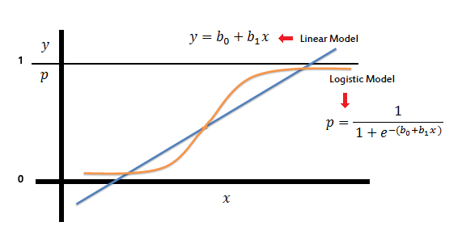
Logistic Regression
Response variable is binary (Survived/Not survived)
Z = Θ'X hΘ(X) = sigmoid (Z) = 1 / (1 + e^(-Z))
Hyperparameter Selection using Random-Search (200 iterations)
'C': 0.054 (Inverse of regularization strength, smaller values = stronger regularization)
'penalty': 'l1'
Training Set Accuracy: 84.34% (sd: 5.4% 10-fold CV)

Slide 21
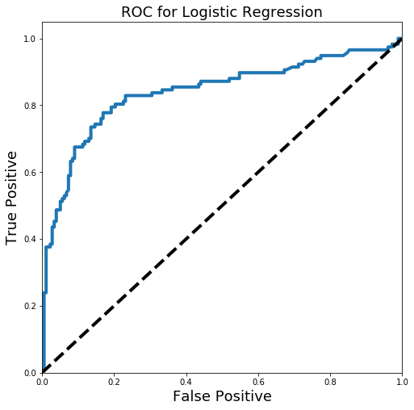
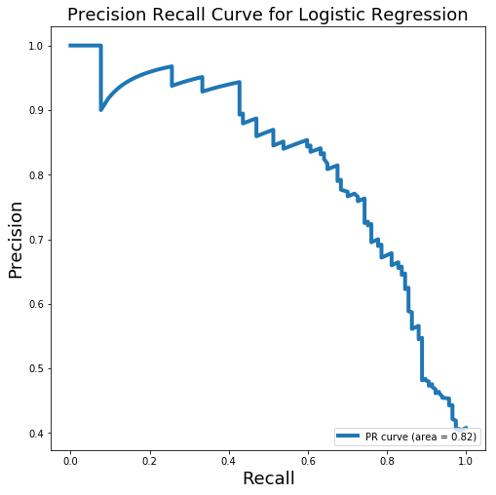
Logistic Regression (Cont’d)
Testing Set Accuracy: 80.61%
ROC_AUC : 0.839

Slide 22
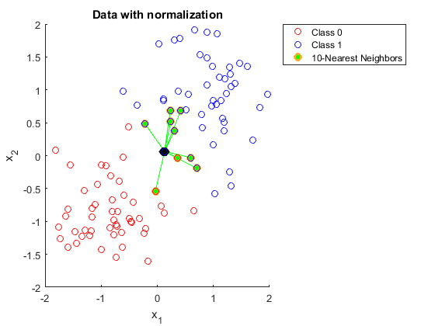
K-Nearest Neighbors(KNN)
The passenger being assigned to the class most common among its k nearest neighbors (k is a positive integer).
Hyperparameter Selection using Random-Search (200 iterations)
'n_neighbors': 13
'weights': 'uniform' is better than 'distance'
Training Set Accuracy: 80.30% (sd: 4.1% 10-fold CV)

Slide 23
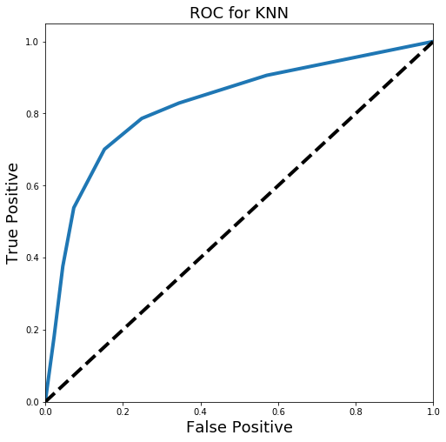
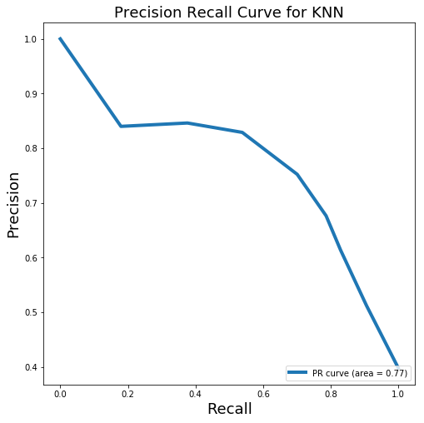
K-Nearest Neighbors(KNN) (Cont’d)
Testing Set Accuracy: 78.91%
ROC_AUC : 0.824

Slide 24
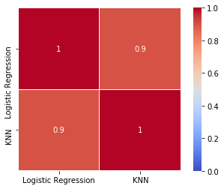
Testing set predictions & Comparisons
The predictions are different between two models.
Appropriate combination of multiple classification algorithm might achieve higher accuracy

Slide 25
Future Plans
Two more non-parametric classification algorithms
Support Vector Machines
Gaussian Process Classifier
Ensemble of the models (e.g. soft-voting)

